Slide 1

Slide 3- 1
Notes:
1

Slide 2
Module 2.1
Data Modeling Using the Entity-Relationship (ER) Model
Copyright © 2007 Ramez Elmasri and Shamkant B. Navathe
Notes:
2

Slide 3
Chapter Outline
Overview of Database Design Process
Example Database Application (COMPANY)
ER Model Concepts
Entities and Attributes
Entity Types, Value Sets, and Key Attributes
Relationships and Relationship Types
Weak Entity Types
Roles and Attributes in Relationship Types
ER Diagrams - Notation
ER Diagram for COMPANY Schema
Alternative Notations – UML class diagrams, others
Slide 3- 3
Notes:
3

Slide 4
Overview of Database Design Process
Two main activities:
Database design
Applications design
Focus in this chapter on database design
To design the conceptual schema for a database application
Applications design focuses on the programs and interfaces that access the database
Generally considered part of software engineering
Slide 3- 4

Slide 5
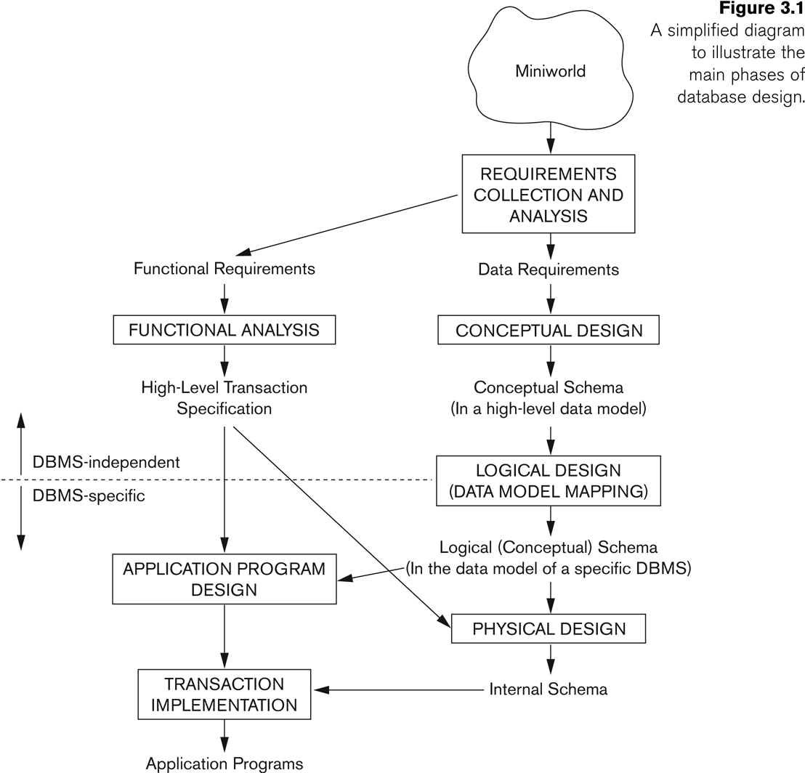
Overview of Database Design Process
Slide 3- 5

Slide 6
Example COMPANY Database
We need to create a database schema design based on the following (simplified) requirements of the COMPANY Database:
The company is organized into DEPARTMENTs. Each department has a name, number and an employee who manages the department. We keep track of the start date of the department manager. A department may have several locations.
Each department controls a number of PROJECTs. Each project has a unique name, unique number and is located at a single location.
Slide 3- 6
Notes:
6

Slide 7
Example COMPANY Database (Contd.)
We store each EMPLOYEE’s social security number, address, salary, sex, and birthdate.
Each employee works for one department but may work on several projects.
We keep track of the number of hours per week that an employee currently works on each project.
We also keep track of the direct supervisor of each employee.
Each employee may have a number of DEPENDENTs.
For each dependent, we keep track of their name, sex, birthdate, and relationship to the employee.
Slide 3- 7
Notes:
7

Slide 8
ER Model Concepts
Entities and Attributes
Entities(noun) are specific objects or things in the mini-world that are represented in the database.
For example the EMPLOYEE John Smith, the Research DEPARTMENT, the ProductX PROJECT
Attributes are properties used to describe an entity.
For example an EMPLOYEE entity may have the attributes Name, SSN, Address, Sex, BirthDate
A specific entity will have a value for each of its attributes.
For example a specific employee entity may have Name='John Smith', SSN='123456789', Address ='731, Fondren, Houston, TX', Sex='M', BirthDate='09-JAN-55‘
Each attribute has a value set (or data type) associated with it – e.g. integer, string, subrange, enumerated type, …
Slide 3- 8
Notes:
8

Slide 9
Types of Attributes (1)
Simple
Each entity has a single atomic value for the attribute. For example, SSN or Sex.
Composite
The attribute may be composed of several components. For example:
Address(Apt#, House#, Street, City, State, ZipCode, Country), or
Name(FirstName, MiddleName, LastName).
Composition may form a hierarchy where some components are themselves composite.
Multi-valued
An entity may have multiple values for that attribute. For example, Color of a CAR or PreviousDegrees of a STUDENT.
Denoted as {Color} or {PreviousDegrees}.
Slide 3- 9
Notes:
9

Slide 10
Types of Attributes (2)
In general, composite and multi-valued attributes may be nested arbitrarily to any number of levels, although this is rare.
For example, PreviousDegrees of a STUDENT is a composite multi-valued attribute denoted by {PreviousDegrees (College, Year, Degree, Field)}
Multiple PreviousDegrees values can exist
Each has four subcomponent attributes:
College, Year, Degree, Field
Slide 3- 10
Notes:
10

Slide 11
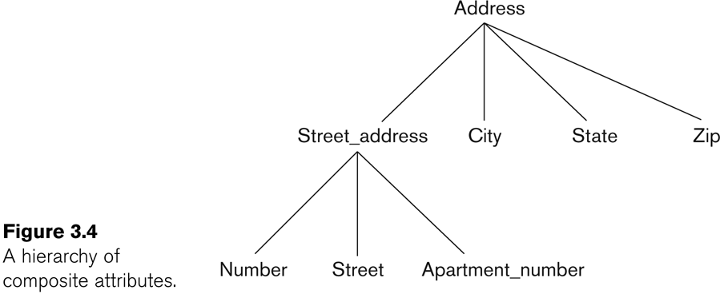
Example of a composite attribute
Slide 3- 11

Slide 12
Entity Types and Key Attributes (1)
Entities with the same basic attributes are grouped or typed into an entity type.
For example, the entity type EMPLOYEE and PROJECT.
An attribute of an entity type for which each entity must have a unique value is called a key attribute of the entity type.
For example, SSN of EMPLOYEE.
Slide 3- 12
Notes:
12

Slide 13
Entity Types and Key Attributes (2)
A key attribute may be composite.
VehicleTagNumber is a key of the CAR entity type with components (Number, State).
An entity type may have more than one key.
The CAR entity type may have two keys:
VehicleIdentificationNumber (popularly called VIN)
VehicleTagNumber (Number, State), aka license plate number.
Each key is underlined
Slide 3- 13
Notes:
13

Slide 14
Displaying an Entity type
In ER diagrams, an entity type is displayed in a rectangular box
Attributes are displayed in ovals
Each attribute is connected to its entity type
Components of a composite attribute are connected to the oval representing the composite attribute
Each key attribute is underlined
Multivalued attributes displayed in double ovals
See CAR example on next slide
Slide 3- 14

Slide 15
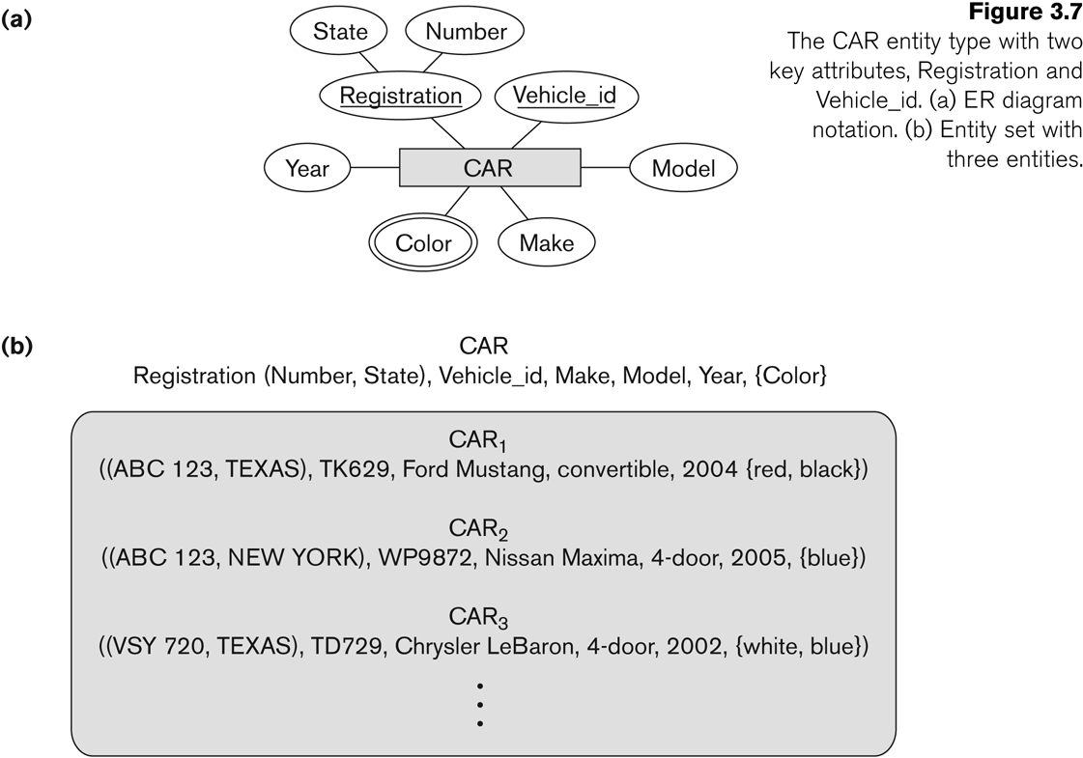
Entity Type CAR with two keys and a corresponding Entity Set
Slide 3- 15

Slide 16
Entity Set
Each entity type will have a collection of entities stored in the database
Called the entity set
Previous slide shows three CAR entity instances in the entity set for CAR
Same name (CAR) used to refer to both the entity type and the entity set
Entity set is the current state of the entities of that type that are stored in the database
Slide 3- 16

Slide 17
Initial Design of Entity Types for the COMPANY Database Schema
Based on the requirements, we can identify four initial entity types in the COMPANY database:
DEPARTMENT
PROJECT
EMPLOYEE
DEPENDENT
Their initial design is shown on the following slide
The initial attributes shown are derived from the requirements description
Slide 3- 17

Slide 18
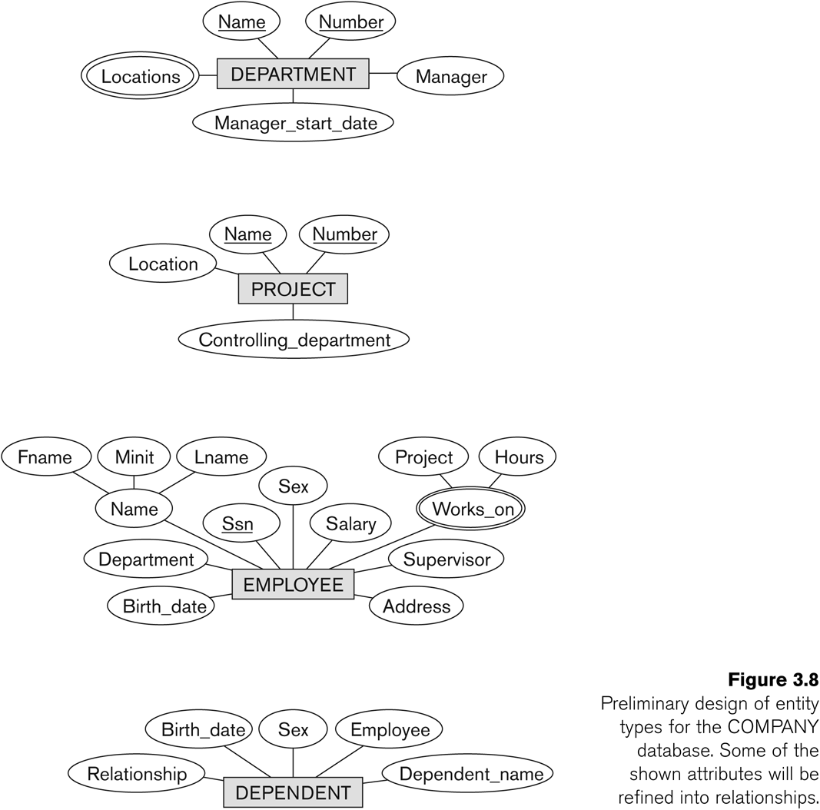
Initial Design of Entity Types: EMPLOYEE, DEPARTMENT, PROJECT, DEPENDENT
Slide 3- 18

Slide 19
Refining the initial design by introducing relationships
The initial design is typically not complete
Some aspects in the requirements will be represented as relationships
ER model has three main concepts:
Entities (and their entity types and entity sets)
Attributes (simple, composite, multivalued)
Relationships (and their relationship types and relationship sets)
We introduce relationship concepts next
Slide 3- 19

Slide 20
Relationships and Relationship Types (1)
A relationship relates two or more distinct entities with a specific meaning.
For example, EMPLOYEE John Smith works on the ProductX PROJECT, or EMPLOYEE Franklin Wong manages the Research DEPARTMENT.
Relationships of the same type are grouped or typed into a relationship type.
For example, the WORKS_ON relationship type in which EMPLOYEEs and PROJECTs participate, or the MANAGES relationship type in which EMPLOYEEs and DEPARTMENTs participate.
The degree of a relationship type is the number of participating entity types.
Both MANAGES and WORKS_ON are binary relationships.
Slide 3- 20
Notes:
20

Slide 21
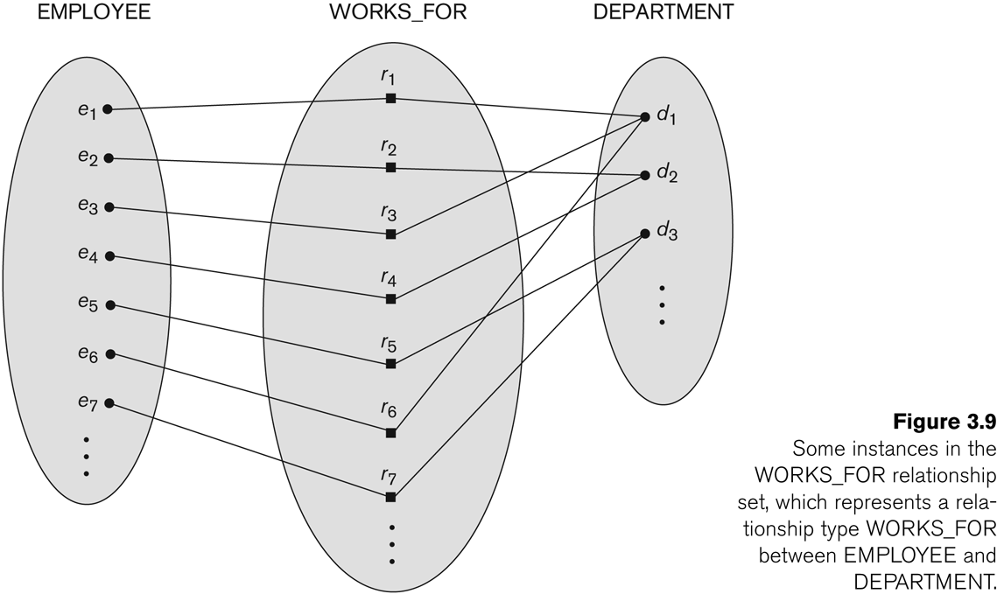
Relationship instances of the WORKS_FOR N:1 relationship between EMPLOYEE and DEPARTMENT
Slide 3- 21
Notes:
21

Slide 22
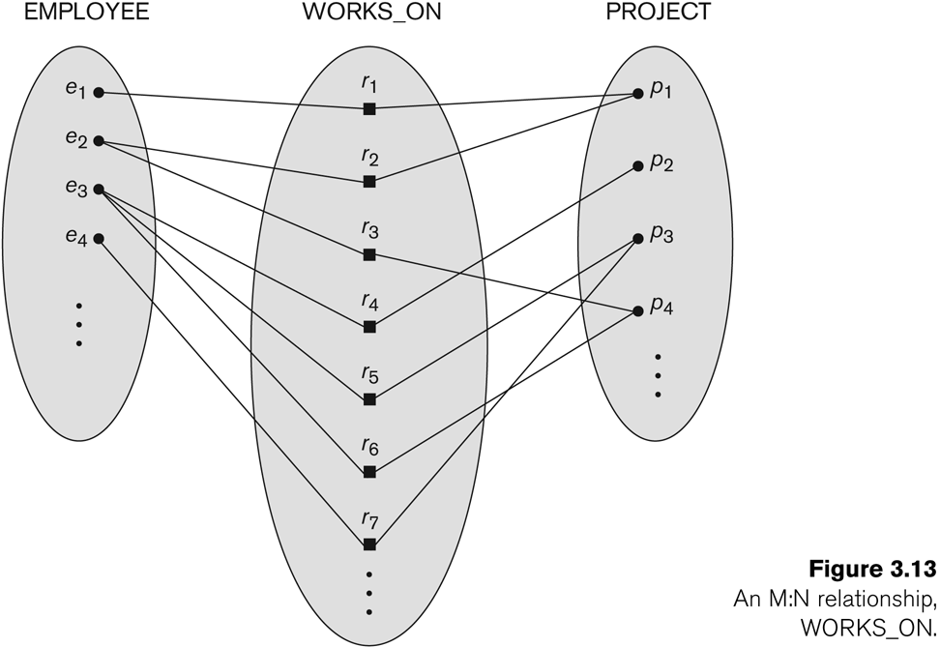
Relationship instances of the M:N WORKS_ON relationship between EMPLOYEE and PROJECT
Slide 3- 22
Notes:
22

Slide 23
Relationship type vs. relationship set (1)
Relationship Type:
Is the schema description of a relationship
Identifies the relationship name and the participating entity types
Also identifies certain relationship constraints
Relationship Set:
The current set of relationship instances represented in the database
The current state of a relationship type
Slide 3- 23

Slide 24
Relationship type vs. relationship set (2)
Previous figures displayed the relationship sets
Each instance in the set relates individual participating entities – one from each participating entity type
In ER diagrams, we represent the relationship type as follows:
Diamond-shaped box is used to display a relationship type
Connected to the participating entity types via straight lines
Slide 3- 24

Slide 25
Refining the COMPANY database schema by introducing relationships
By examining the requirements, six relationship types are identified
All are binary relationships( degree 2)
Listed below with their participating entity types:
WORKS_FOR (between EMPLOYEE, DEPARTMENT)
MANAGES (also between EMPLOYEE, DEPARTMENT)
CONTROLS (between DEPARTMENT, PROJECT)
WORKS_ON (between EMPLOYEE, PROJECT)
SUPERVISION (between EMPLOYEE (as subordinate), EMPLOYEE (as supervisor))
DEPENDENTS_OF (between EMPLOYEE, DEPENDENT)
Slide 3- 25

Slide 26
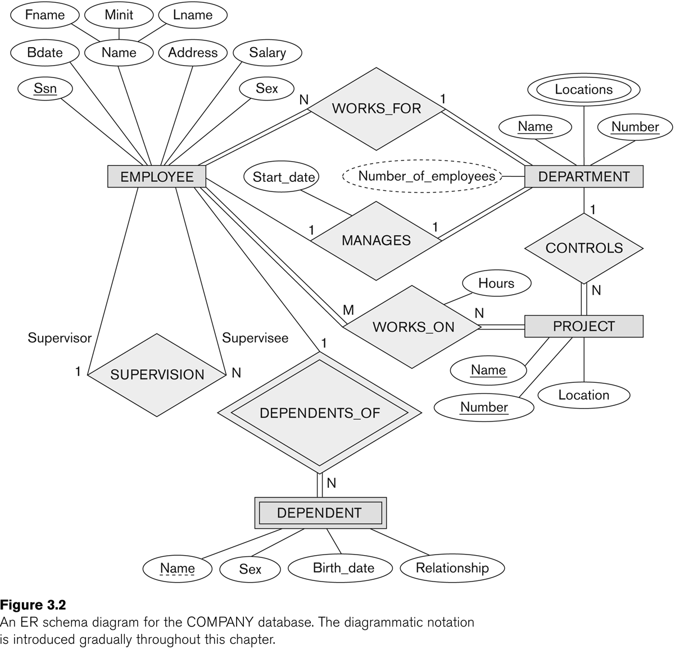
ER DIAGRAM – Relationship Types are: WORKS_FOR, MANAGES, WORKS_ON, CONTROLS, SUPERVISION, DEPENDENTS_OF
Slide 3- 26
Notes:
26

Slide 27
Discussion on Relationship Types
In the refined design, some attributes from the initial entity types are refined into relationships:
Manager of DEPARTMENT -> MANAGES
Works_on of EMPLOYEE -> WORKS_ON
Department of EMPLOYEE -> WORKS_FOR
etc
In general, more than one relationship type can exist between the same participating entity types
MANAGES and WORKS_FOR are distinct relationship types between EMPLOYEE and DEPARTMENT
Different meanings and different relationship instances.
Slide 3- 27
Notes:
27

Slide 28
Recursive Relationship Type
An relationship type whose with the same participating entity type in distinct roles
Example: the SUPERVISION relationship
EMPLOYEE participates twice in two distinct roles:
supervisor (or boss) role
supervisee (or subordinate) role
Each relationship instance relates two distinct EMPLOYEE entities:
One employee in supervisor role
One employee in supervisee role
Slide 3- 28
Notes:
28

Slide 29
Weak Entity Types
An entity that does not have a key attribute
A weak entity must participate in an identifying relationship type with an owner or identifying entity type
Entities are identified by the combination of:
A partial key of the weak entity type
The particular entity they are related to in the identifying entity type
Example:
A DEPENDENT entity is identified by the dependent’s first name, and the specific EMPLOYEE with whom the dependent is related
Name of DEPENDENT is the partial key
DEPENDENT is a weak entity type
EMPLOYEE is its identifying entity type via the identifying relationship type DEPENDENT_OF
Slide 3- 29
Notes:
29

Slide 30
Constraints on Relationships
Constraints on Relationship Types
(Also known as ratio constraints)
Cardinality Ratio (specifies maximum participation)
One-to-one (1:1)
One-to-many (1:N) or Many-to-one (N:1)
Many-to-many (M:N)
Existence Dependency Constraint (specifies minimum participation) (also called participation constraint)
zero (optional participation, not existence-dependent)
one or more (mandatory participation, existence-dependent)
Slide 3- 30
Notes:
30

Slide 31
Many-to-one (N:1) Relationship
Slide 3- 31
Notes:
31

Slide 32
Many-to-many (M:N) Relationship
Slide 3- 32
Notes:
32

Slide 33
Displaying a recursive relationship
In a recursive relationship type.
Both participations are same entity type in different roles.
For example, SUPERVISION relationships between EMPLOYEE (in role of supervisor or boss) and (another) EMPLOYEE (in role of subordinate or worker).
In following figure, first role participation labeled with 1 and second role participation labeled with 2.
In ER diagram, need to display role names to distinguish participations.
Slide 3- 33
Notes:
33

Slide 34
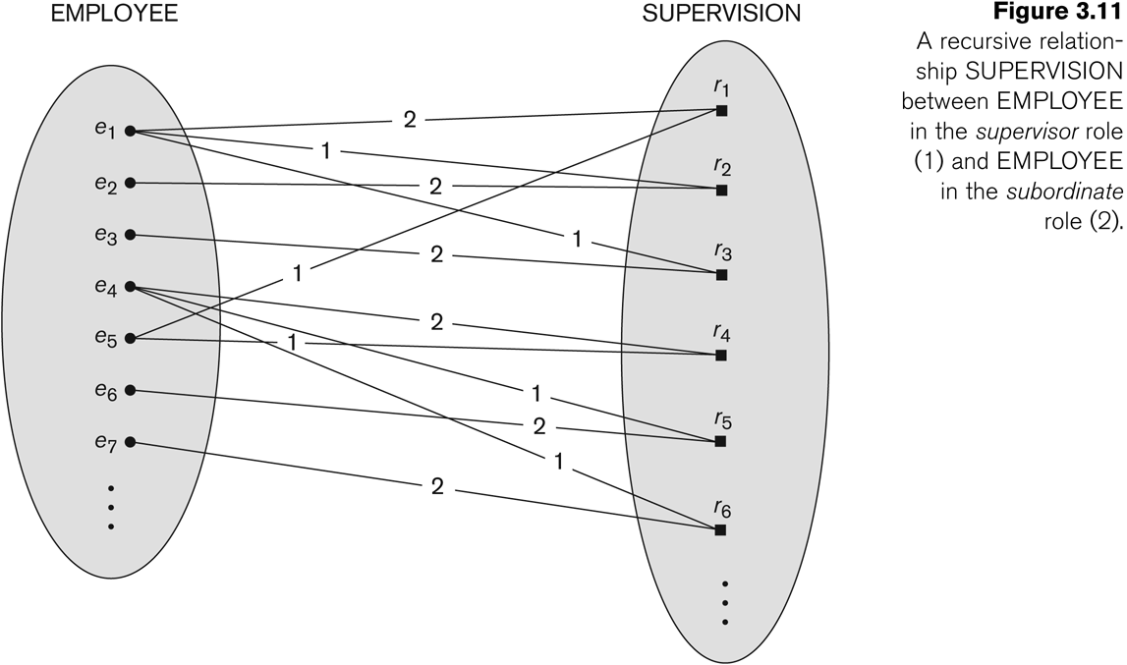
A Recursive Relationship Supervision`
Slide 3- 34
Notes:
34

Slide 35
Recursive Relationship Type is: SUPERVISION (participation role names are shown)
Slide 3- 35
Notes:
35

Slide 36
Attributes of Relationship types
A relationship type can have attributes:
For example, HoursPerWeek of WORKS_ON
Its value for each relationship instance describes the number of hours per week that an EMPLOYEE works on a PROJECT.
A value of HoursPerWeek depends on a particular (employee, project) combination
Most relationship attributes are used with M:N relationships
In 1:N relationships, they can be transferred to the entity type on the N-side of the relationship
Slide 3- 36
Notes:
36

Slide 37
Example Attribute of a Relationship Type: Hours of WORKS_ON
Slide 3- 37
Notes:
37

Slide 38
Notation for Constraints on Relationships
Cardinality ratio (of a binary relationship): 1:1, 1:N, N:1, or M:N
Shown by placing appropriate numbers on the relationship edges.
Participation constraint (on each participating entity type): total (called existence dependency) or partial.
Total shown by double line, partial by single line.
NOTE: These are easy to specify for Binary Relationship Types.
Slide 3- 38
Notes:
38

Slide 39
Alternative (min, max) notation for relationship structural constraints:
Specified on each participation of an entity type E in a relationship type R
Specifies that each entity e in E participates in at least min and at most max relationship instances in R
Default(no constraint): min=0, max=n (signifying no limit)
Must have min≤max, min≥0, max ≥1
Derived from the knowledge of mini-world constraints
Examples:
A department has exactly one manager and an employee can manage at most one department.
Specify (0,1) for participation of EMPLOYEE in MANAGES
Specify (1,1) for participation of DEPARTMENT in MANAGES
An employee can work for exactly one department but a department can have any number of employees.
Specify (1,1) for participation of EMPLOYEE in WORKS_FOR
Specify (0,n) for participation of DEPARTMENT in WORKS_FOR
Slide 3- 39
Notes:
39

Slide 40
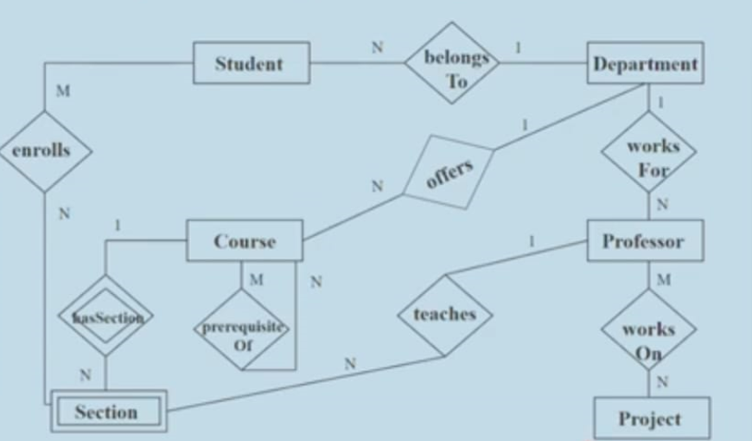
ER diagram for the Institute database cas study (Shared in classroom)
The attributes of entity types should be specified. It is not mentioned due to space constraints

Slide 41
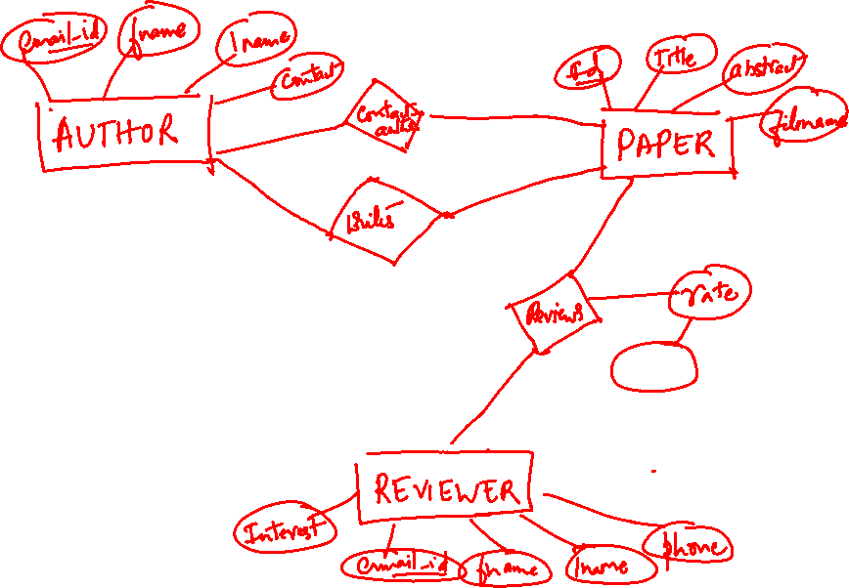
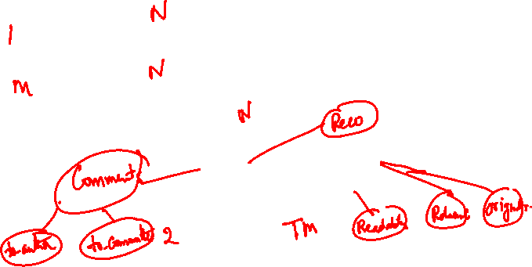
ER diagram for CONFERENCE_REVIEW database(Shared in classroom)
Try!!

Slide 42
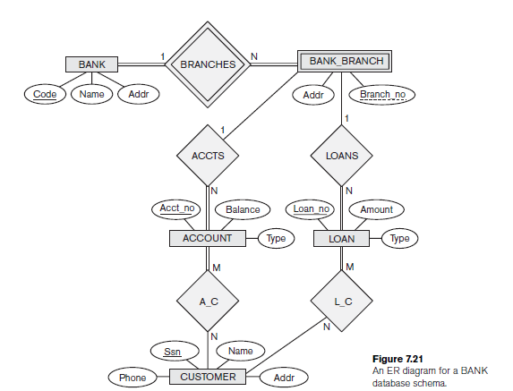
ER diagram for BANK databaese

Slide 43
Answer the following questions
List the strong (nonweak) entity types in the ER diagram.
Entity types: BANK, ACCOUNT, CUSTOMER, LOAN

Slide 44
Answer the following questions
Is there a weak entity type? If so, give its name, partial key, and identifying relationship.
Weak entity type: BANK-BRANCH. Partial key: BranchNo. Identifying relationship: BRANCHES

Slide 45
Answer the following questions
What constraints do the partial key and the identifying relationship of the weak entity type specify in this diagram
The partial key BranchNo in BANK-BRANCH specifies that the same BranchNo value may occur under different BANKs. The identifying relationship BRANCHES specifies that BranchNo values are uniquely assigned for those BANK-BRANCH entities that are related to the same BANK entity. Hence, the combination of BANK Code and BranchNo together constitute a full identifier for a BANK-BRANCH.

Slide 46
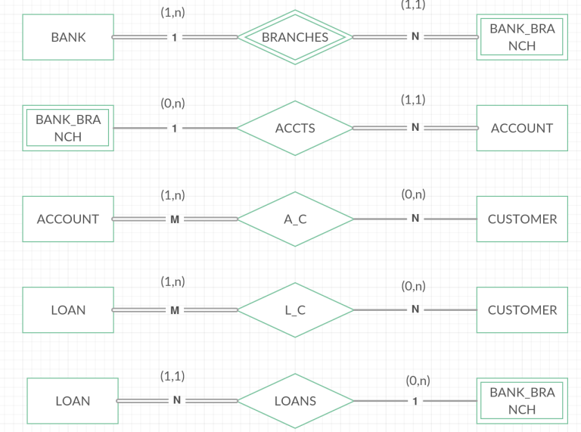
Answer the following questions
List the names of all relationship types, and specify the (min, max) constraint on each participation of an entity type in a relationship type. Justify your choices.

Slide 47
Answer the following questions
List concisely the user requirements that led to this ER schema design
Each BANK has a unique Code, as well as a Name and Address. Each BANK is related to one or more BANK-BRANCHes, and the BranhNo is unique among each set of BANK-BRANCHes that are related to the same BANK. Each BANK-BRANCH has an Address. Each BANK-BRANCH has zero or more LOANS and zero or more ACCTS. Each ACCOUNT has an AcctNo (unique), Balance, and Type and is related to exactly one BANK-BRANCH and to at least one CUSTOMER. Each LOAN has a LoanNo (unique), Amount, and Type and is related to exactly one BANK-BRANCH and to at least one CUSTOMER. Each CUSTOMER has an SSN (unique), Name, Phone, and Address, and is related to zero or more ACCOUNTs and to zero or more LOANs.

Slide 48
Suppose that every customer must have at least one account but is restricted to at most two loans at a time, and that a bank branch cannot have more than 1,000 loans. How does this show up on the (min, max) constraints?

Slide 49
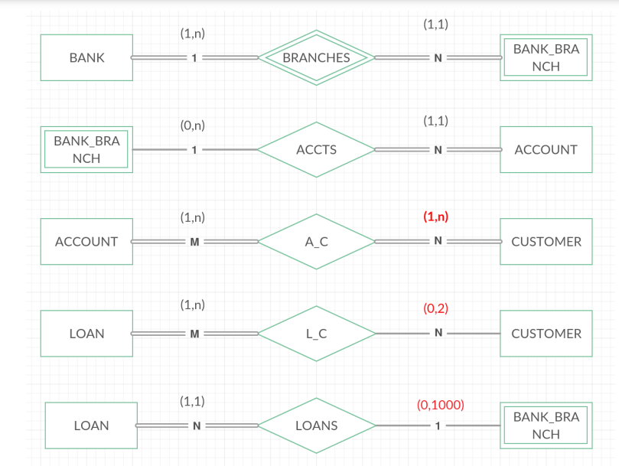

Slide 50
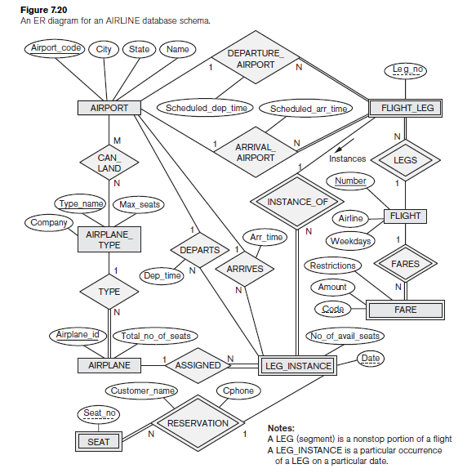

Slide 51
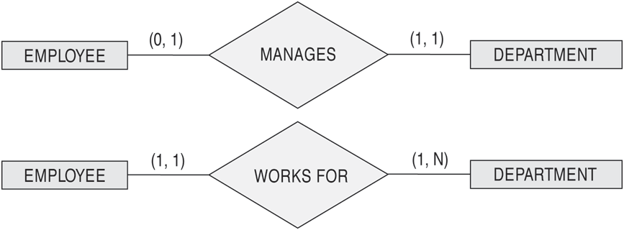
The (min,max) notation for relationship constraints
Read the min,max numbers next to the entity type and looking away from the entity type
Slide 3- 51
Notes:
51

Slide 52
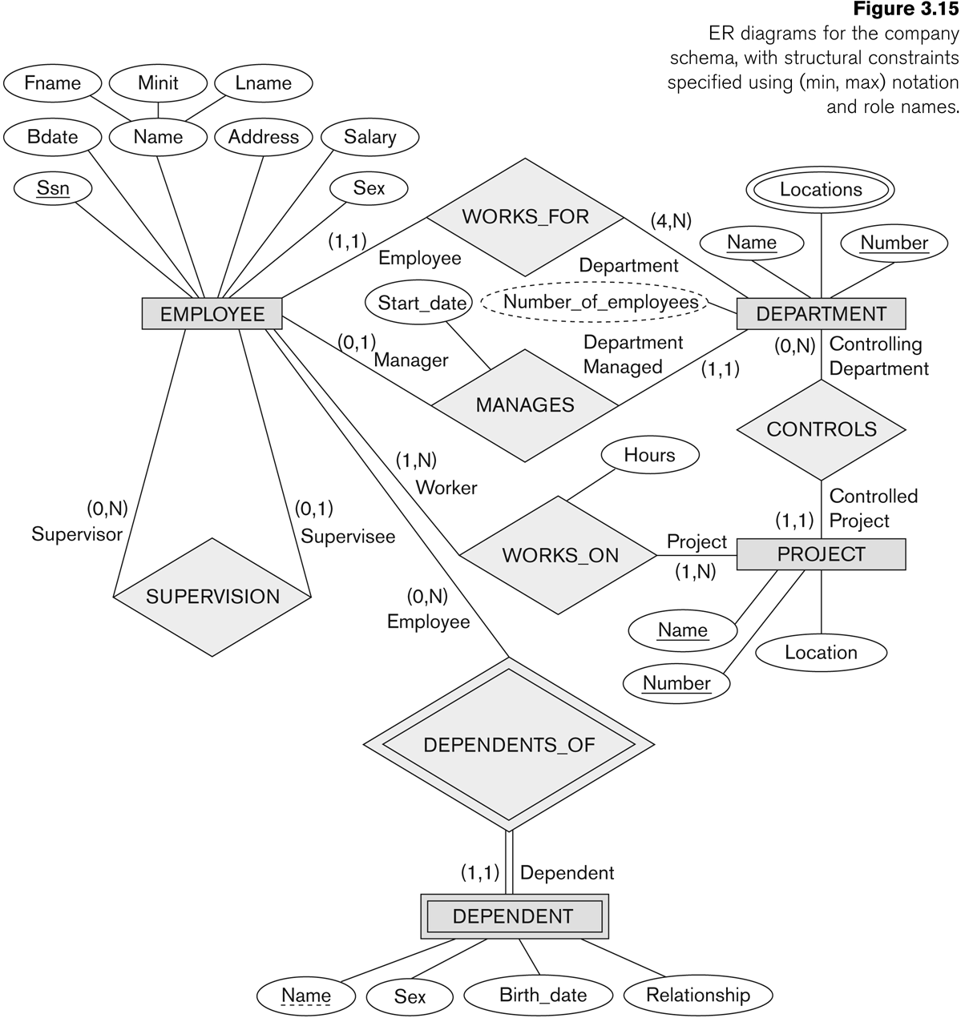
COMPANY ER Schema Diagram using (min, max) notation
Slide 3- 52
Notes:
52

Slide 53
Alternative diagrammatic notation
ER diagrams is one popular example for displaying database schemas
Many other notations exist in the literature and in various database design and modeling tools
Appendix A illustrates some of the alternative notations that have been used
UML class diagrams is representative of another way of displaying ER concepts that is used in several commercial design tools
Slide 3- 53

Slide 54
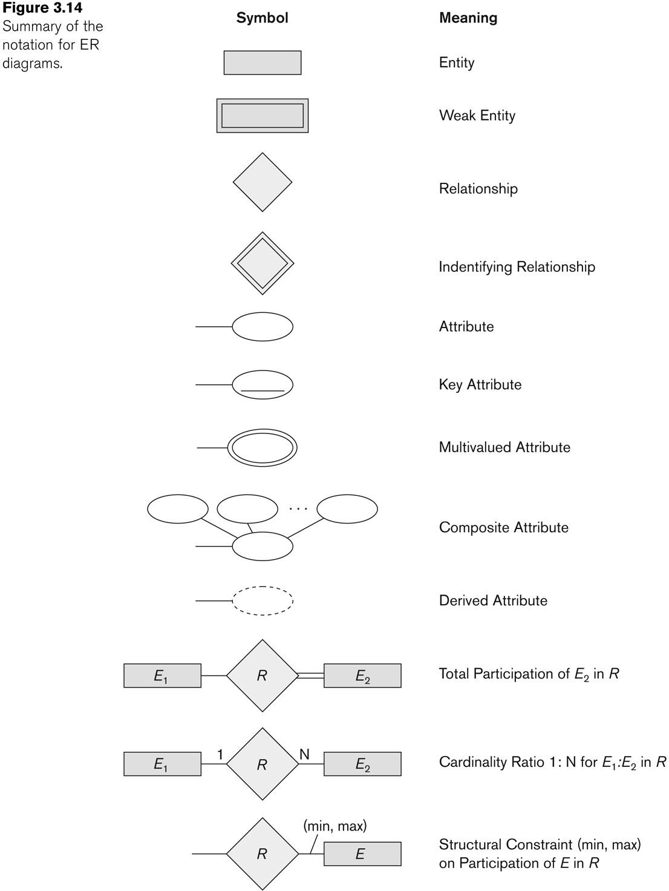
Summary of notation for ER diagrams
Slide 3- 54

Slide 55
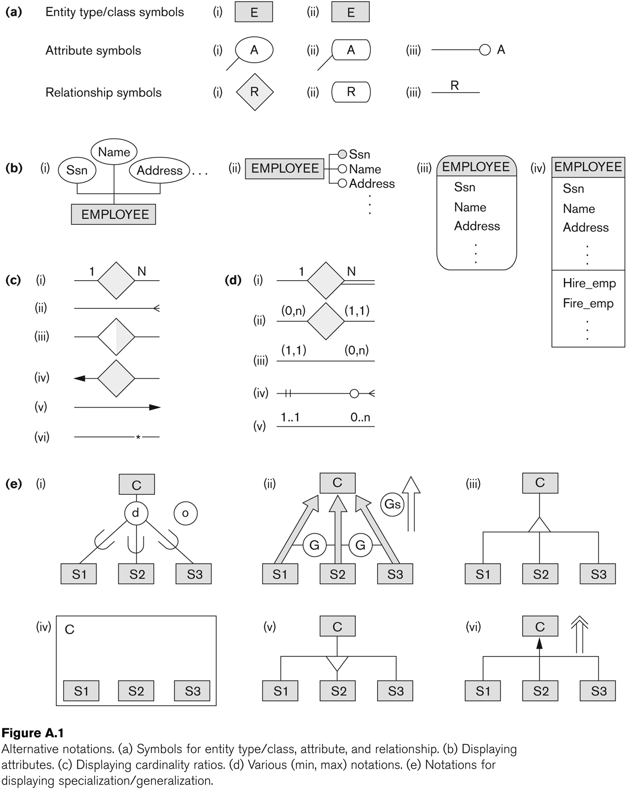
Other alternative diagrammatic notations
Slide 3- 55

Slide 56
Relationships of Higher Degree
Relationship types of degree 2 are called binary
Relationship types of degree 3 are called ternary and of degree n are called n-ary
In general, an n-ary relationship is not equivalent to n binary relationships
Constraints are harder to specify for higher-degree relationships (n > 2) than for binary relationships
Slide 3- 56
Notes:
56

Slide 57
Discussion of n-ary relationships (n > 2)
In general, 3 binary relationships can represent different information than a single ternary relationship
If needed, the binary and n-ary relationships can all be included in the schema design
In some cases, a ternary relationship can be represented as a weak entity if the data model allows a weak entity type to have multiple identifying relationships (and hence multiple owner entity types)
Slide 3- 57

Slide 58
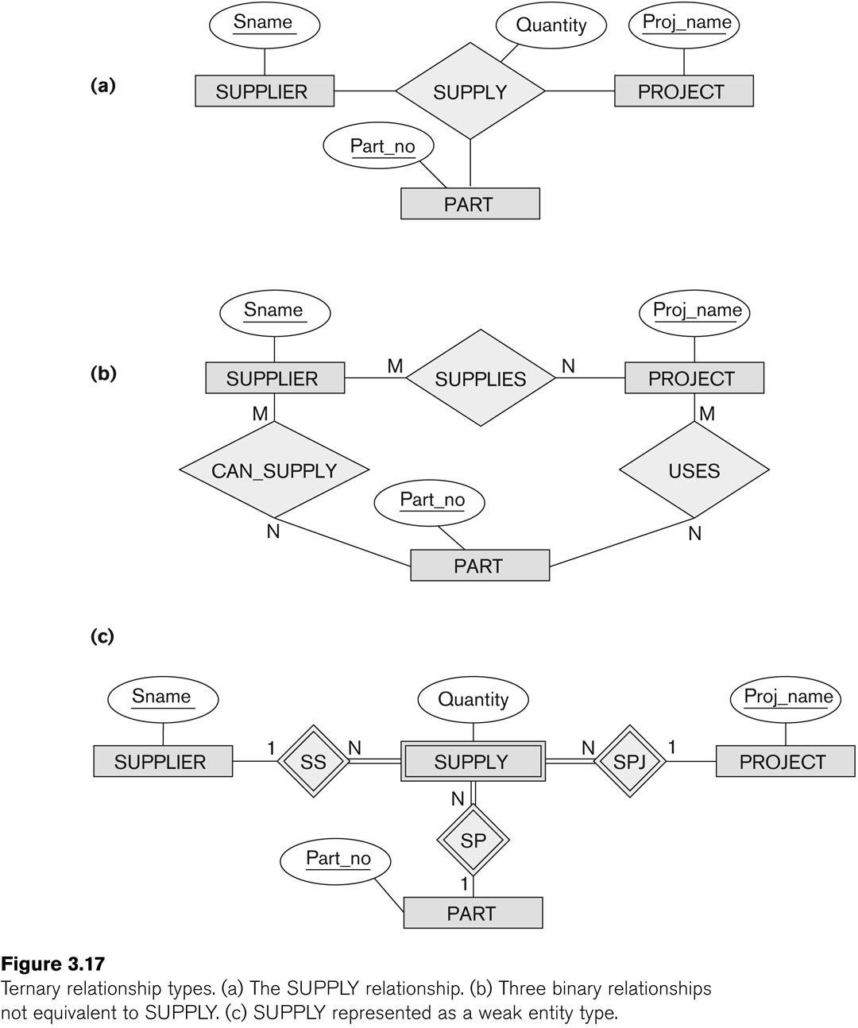
Example of a ternary relationship
Slide 3- 58

Slide 59
Discussion of n-ary relationships (n > 2)
If a particular binary relationship can be derived from a higher-degree relationship at all times, then it is redundant
For example, the TAUGHT_DURING binary relationship in Figure 3.18 (see next slide) can be derived from the ternary relationship OFFERS (based on the meaning of the relationships)
Slide 3- 59

Slide 60
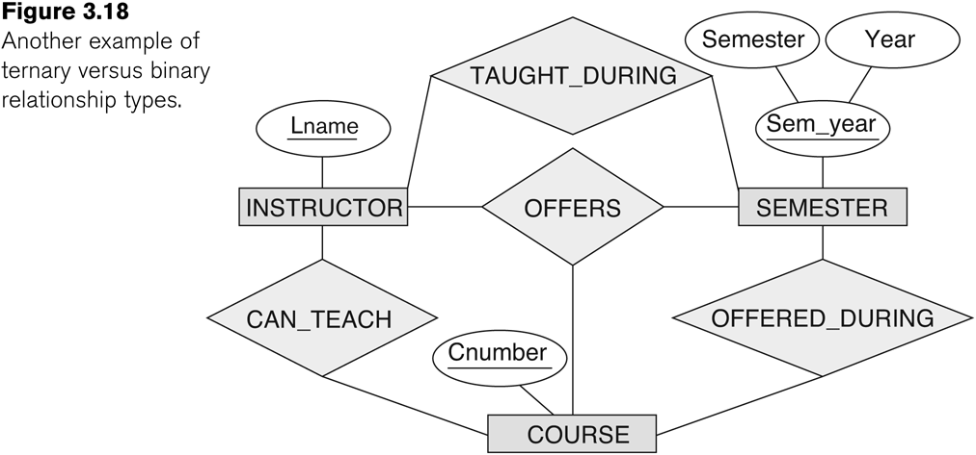
Another example of a ternary relationship
Slide 3- 60

Slide 61
Displaying constraints on higher-degree relationships
The (min, max) constraints can be displayed on the edges – however, they do not fully describe the constraints
Displaying a 1, M, or N indicates additional constraints
An M or N indicates no constraint
A 1 indicates that an entity can participate in at most one relationship instance that has a particular combination of the other participating entities
In general, both (min, max) and 1, M, or N are needed to describe fully the constraints
Slide 3- 61

Slide 62
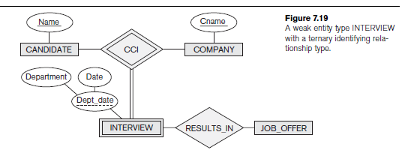
Weak entity with ternary identifying relationship

Slide 63
Employment agency Database that keeps track of candidates interviewing for jobs at various companies . A candidate can have multiple interviews with the same company (for example, with different company departments or on separate dates), but a job offer is made based on one of the interviews. Here, INTERVIEW is represented as a weak entity with two owners CANDIDATE and COMPANY, and with the partial key Dept_date. An INTERVIEW entity is uniquely identified by a candidate, a company, and the combination
of the date and department of the interview.

Slide 64
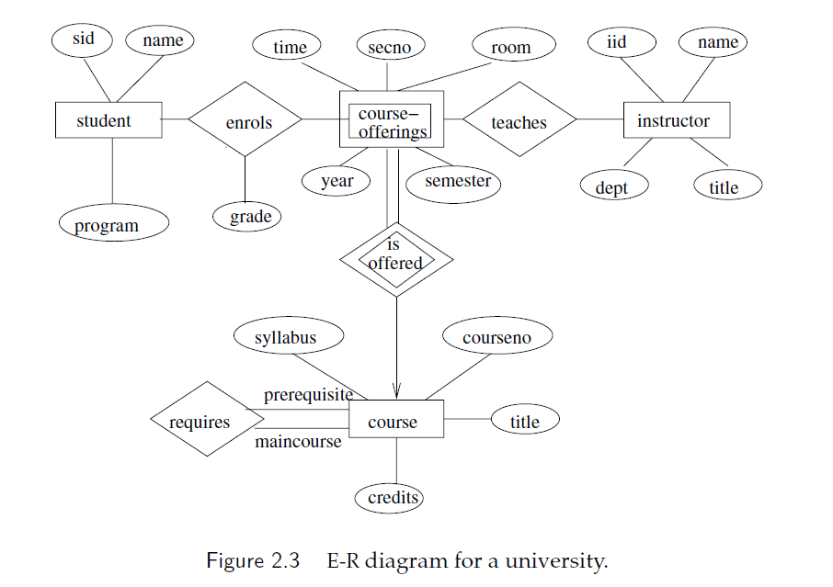

Slide 65
Design an E-R diagram for keeping track of the exploits of your favourite sports
team. You should store the matches played, the scores in each match, the players
in each match and individual player statistics for each match. Summary statistics
should be modeled as derived attributes.

